Slide 1
RECAP

Slide 2
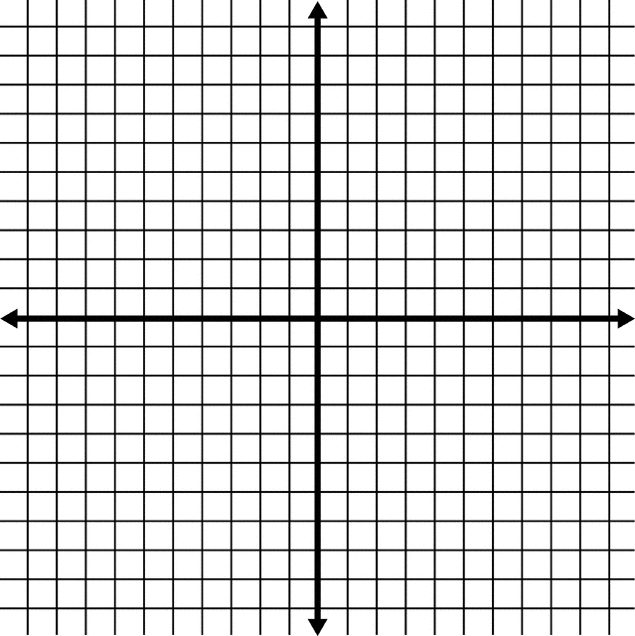
y = -2x + 4
y = x – 2

Slide 3
TEST CONDITIONS
POP QUIZ

Slide 4
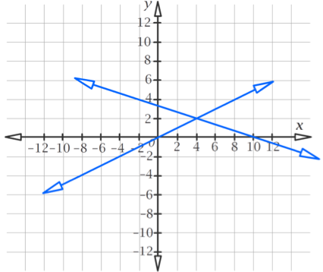
What is the simultaneous solution to these two linear lines?
Q1

Slide 5
Graph the lines: y=3x-1 y=-4x+6 What is the solution that satisfies both equations?
Q2

Slide 6
Line “a” passes through (-2,6) and (4,0) Line “b” passes through (-2,-1) and (2,2) Graph these lines and find where they intersect
Q3

Slide 7
Topic: simultaneous equations
EQ: How do I solve simultaneous equations algebraically, without graphing them?

Slide 8
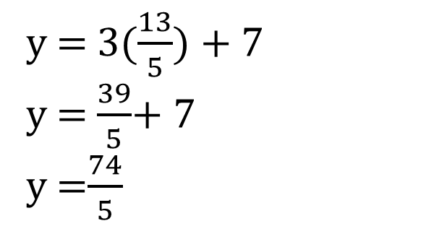
Part 1 → substitution method
The first equation tells us what y is, so we can substitute 3x+7 into the second equation where y is
Now that we know x=13/5 we can sub that back into either of the equations and solve for y
y = 3x + 7
2x + y = 20
2x + (3x + 7) = 20
2x + 3x + 7 = 20
5x + 7 = 20
5x = 20 – 7
5x = 13
x = 13/5
By substituting we obtain an equation with only one variable, which we can solve by applying our knowledge of balancing equations
y = 3($\frac{13}{5}$) + 7
y = $\frac{39}{5}$+ 7
y =$\frac{74}{5}$

Slide 9
